Slide 1
Halloween

Slide 2
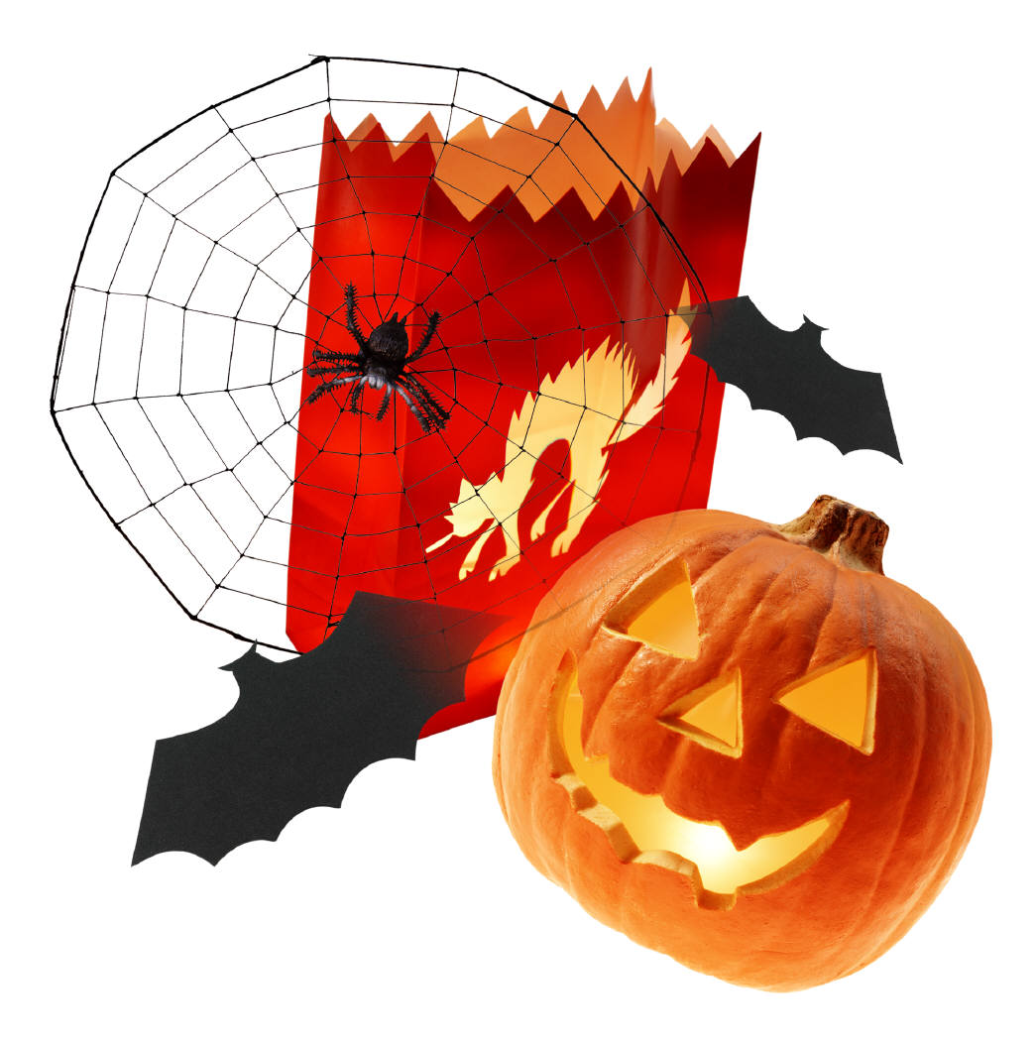
Halloween is __ holiday (1) in the UK, the USA and Ireland.
People celebrate it __ (2) 31 October.

Slide 3
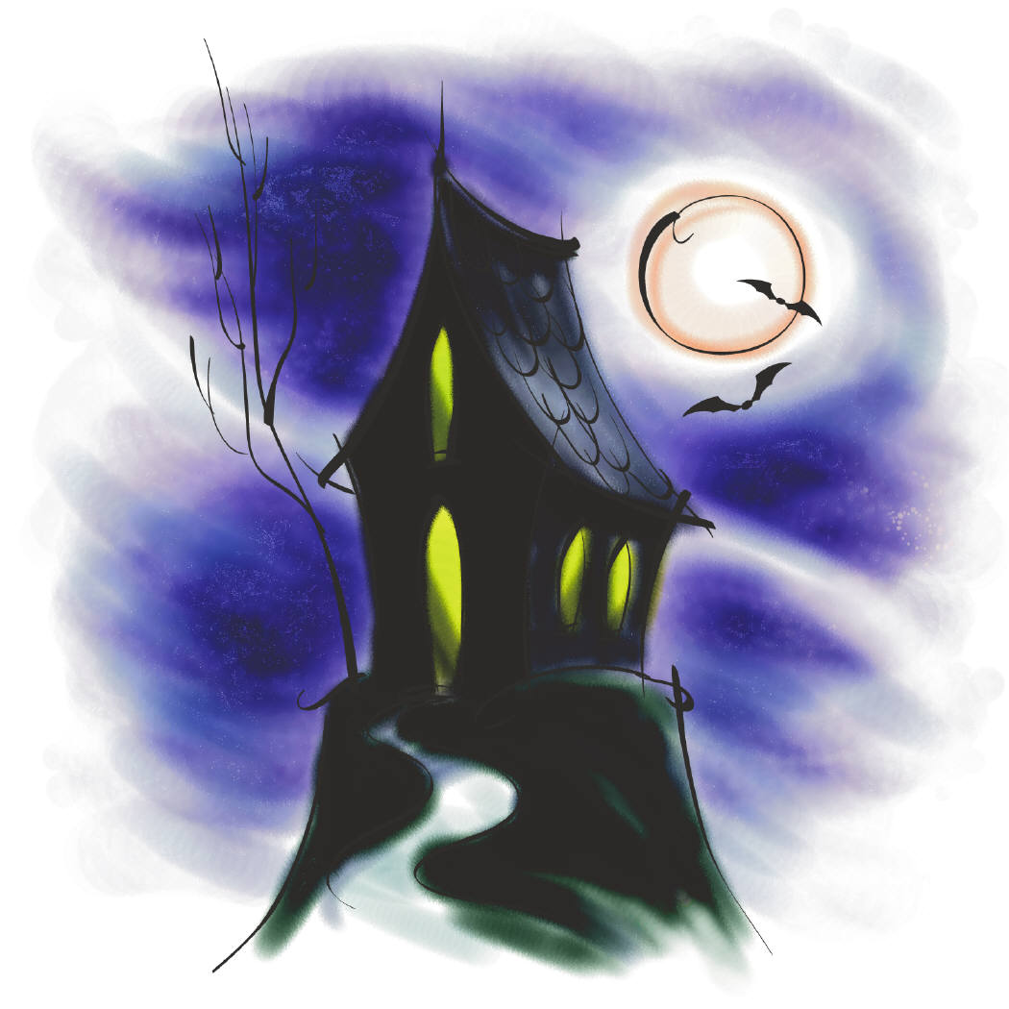
People think that __ (3) is a holiday of ghosts.
Ghosts haunt old empty houses __ (4) castles.

Slide 4
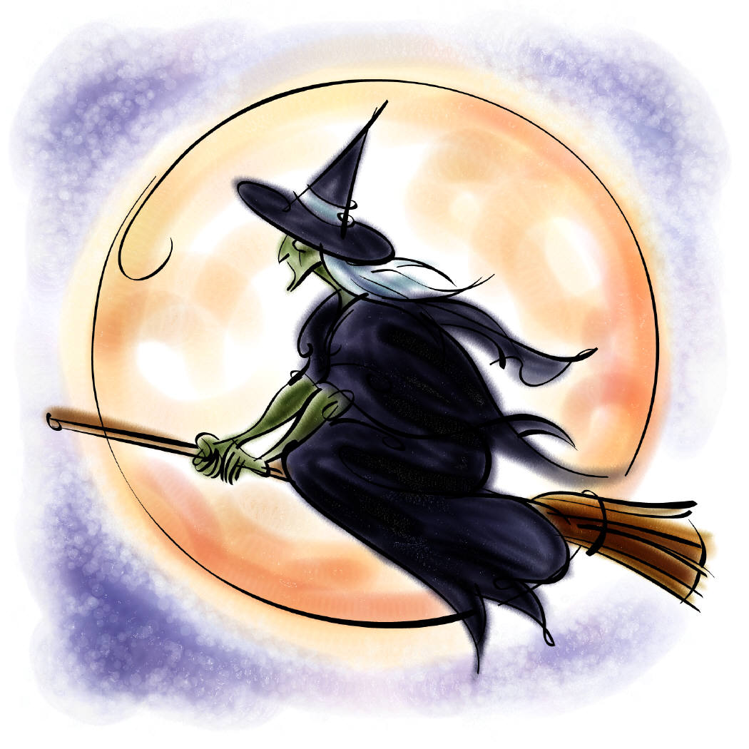
It is __ (5) a holiday of witches.
They fly their brooms to special parties on 31 October night.

Slide 5
Most of all,
Halloween is a holiday of children now.
Children make lanterns from big yellow _____ (6) .

Slide 6
How __ (7) they make them?
First they cut off the top __ (8) take out the inside of the pumpkin.

Slide 7
Then they make the face __ (9) a sharp knife.
They cut out the __ (10), the nose and the mouth with teeth.

Slide 8
__ (11) the end they light a candle and put it inside the lantern.
They put the lit lanterns in windows.

Slide 9
Halloween is more fun __ (12) just making pumpkin lanterns.
Children dress __ (13) as monsters and pirates.

Slide 10
They also wear masks __ (14) ghosts, devils and witches.
Then they visit their neighbours and say : „Trick or __ (15) !“

Slide 11
People __ (16) want a trick, __ (17) they treat them – they give them chocolates, candies and sweets.

Slide 12
Nowadays, children often say they don´t want sweets __ (18) some money for UNICEF.
UNICEF gives the money to poor children.
UNICEF

Slide 13
The End

